Slide 1

REXTON MACHADO A – MBE11
Crafting & Compelling Website Analysis, Audit and Recommendations
WEBSITE : www.tcs.com

Slide 2

About Company
Tata Consultancy Services (TCS) is a global leader in IT services, consulting, and business solutions. With a presence in over 50 countries, TCS provides a wide range of services, including software development, digital transformation, cloud computing, and AI-driven solutions. The company partners with businesses across various industries to drive innovation, enhance operational efficiency, and deliver exceptional customer experiences. TCS is known for its strong commitment to sustainability, corporate social responsibility, and its investment in cutting-edge technologies. By leveraging its global delivery network and deep domain expertise, TCS helps clients navigate complex challenges and achieve their business objectives.

Slide 3

Company Services
ARTIFICIAL INTELLIGENCE
Tata Consultancy Services (TCS) delivers AI-driven solutions that enhance decision-making, automate processes, and drive innovation. Their expertise in AI helps businesses integrate advanced technologies for improved efficiency and growth.
DATA AND ANALYTICS
TCS offers cutting-edge Data and Analytics services, empowering businesses to unlock actionable insights and drive growth. Leveraging advanced analytics, AI, and machine learning, TCS helps organizations transform raw data into valuable intelligence, enabling informed decision-making, operational efficiency, and enhanced customer experiences.
CYBERSECURITY
TCS Cybersecurity offers comprehensive protection with advanced threat detection, risk management, and compliance solutions. Safeguard your enterprise from evolving cyber threats with our cutting-edge technology and expert support, ensuring your business remains secure and resilient

Slide 4
COGNITIVE BUSINESS OPERATIONS
TCS’s Cognitive Business Operations (CBO) transforms enterprises through intelligent automation, AI-driven decision-making, and data-led insights. Our CBO services integrate cutting-edge technologies to enhance business agility, streamline processes, and boost productivity. Discover how we empower organizations to stay ahead of the competition by creating a resilient, adaptive business ecosystem that leverages cognitive capabilities for continuous improvement and innovation.
NETWORK SOLUTIONS AND SERVICES
Discover robust Network Solutions and Services at TCS, designed to enhance your enterprise's connectivity and performance. We offer end-to-end network solutions, from design and implementation to ongoing management and optimization. Our services ensure seamless integration with your existing infrastructure, providing secure, scalable, and efficient networks that support your business objectives. With a focus on innovation and reliability, TCS helps you stay ahead in the rapidly evolving digital landscape. Trust us to deliver the connectivity you need to drive growth and success.

Slide 5
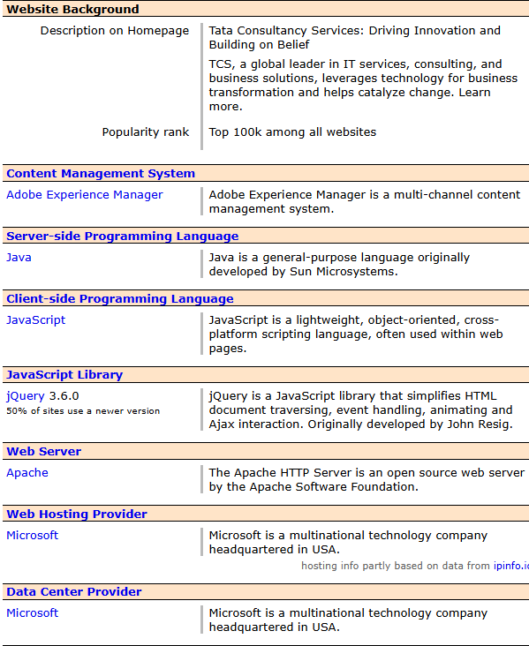

Website Platform Identifaction

Slide 6
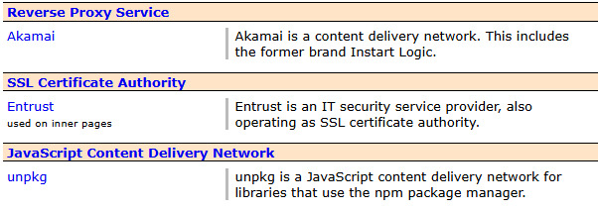
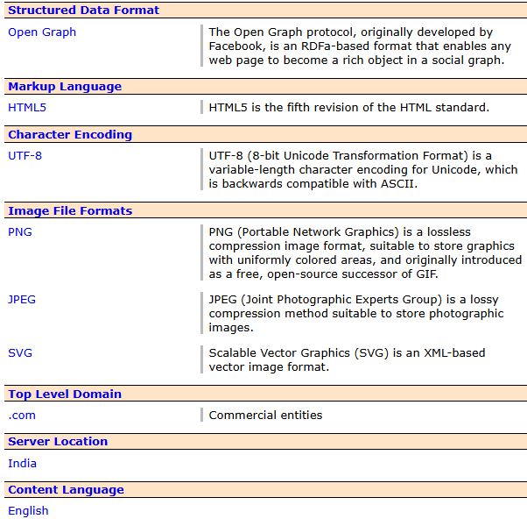
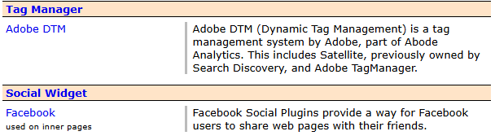


Slide 7
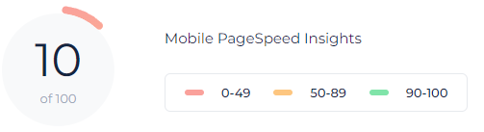
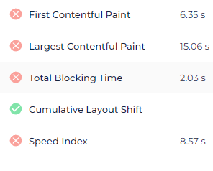
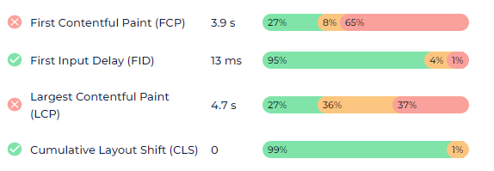
Responsive Design
SERVICE PAGE : ARTIFICIAL INTELLIGENCE
Website URL: https://www.tcs.com/what-we-do/services/artificial-intelligence

Slide 8
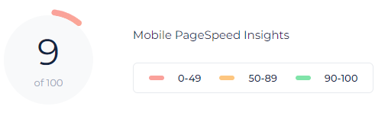
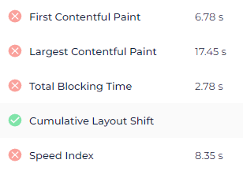
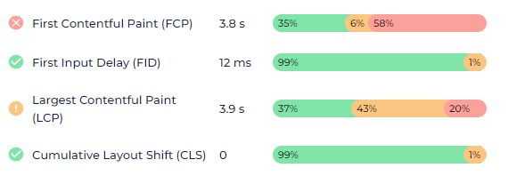
SERVICE PAGE : CYBERSECURITY
Website URL: https://www.tcs.com/what-we-do/services/cybersecurity

Slide 9
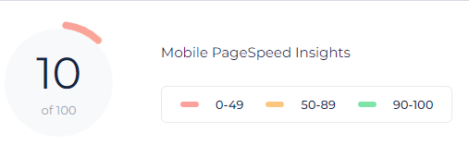
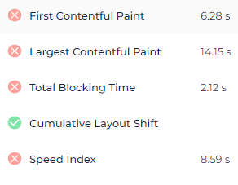
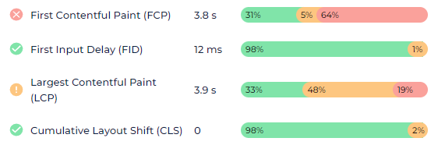
SERVICE PAGE : DATA AND ANALYTICS
Website URL: https://www.tcs.com/what-we-do/services/cybersecurity

Slide 10
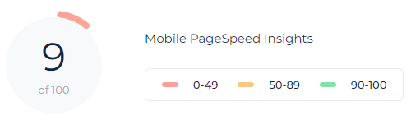
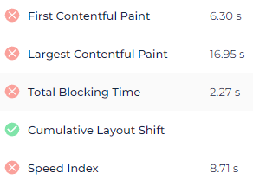
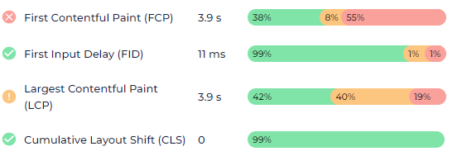
SERVICE PAGE : COGNITIVE BUSINESS OPERATIONS
Website URL: https://www.tcs.com/what-we-do/services/cybersecurity

Slide 11
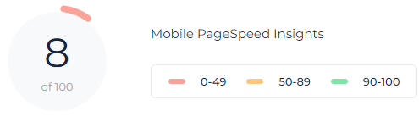
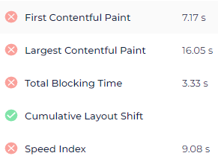
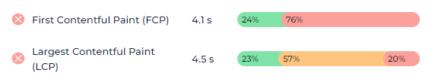
SERVICE PAGE : NETWORK SOLUTIONS AND SERVICES
Website URL: https://www.tcs.com/what-we-do/services/network-solutions-and-services

Slide 12
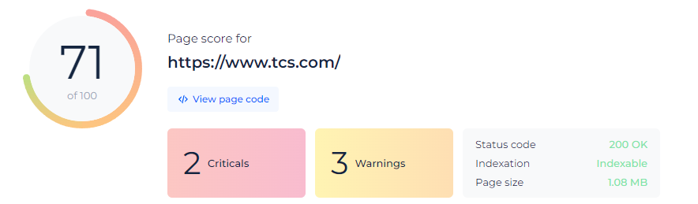
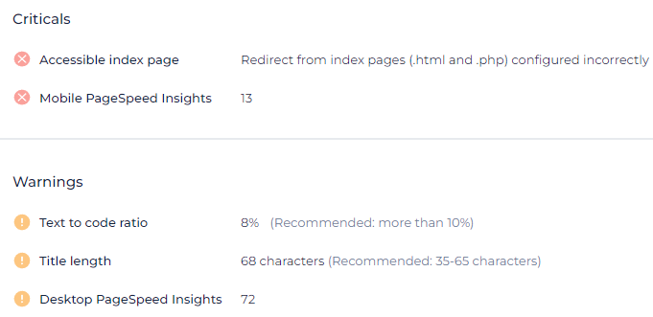
Website Mistake Identification
Find what is decreasing the ranking score of https://www.tcs.com/ website.

Slide 13
Best Practices list
Clear and Simple Navigation
Fast Loading Times
Use a clear and consistent navigation structure.
Limit the number of menu items to avoid overwhelming users.
Implement a sticky or fixed navigation bar for easy access.
Optimize images, use efficient code, and leverage caching to reduce load times.
Aim for load times under 3 seconds.
Responsive Design
Intuitive Layout
Ensure the website is mobile-friendly and adapts to different screen sizes.
Test across multiple devices and browsers.
Place important content above the fold.
Use grid layouts for a clean, organized appearance.
Utilize white space effectively to avoid clutter.
Feedback Mechanism
Consistent Branding
Use a consistent color scheme, fonts, and logo placement throughout the site.
Align the design with your brand identity.
Provide users with a way to give feedback, such as surveys or a contact form.
Use feedback to make continuous improvements to the site.

Slide 14
High-Quality Visuals
User-Focused Content
Use high-resolution images, videos, and graphics.
Avoid stock images that feel generic or impersonal.
Write concise, engaging content that addresses user needs.
Use bullet points, headings, and subheadings for easy scanning.
Readable Typography
Use easy-to-read fonts with appropriate sizes (16px+ for body text).
Ensure good contrast between text and background.
Search Functionality
Implement a search bar that provides relevant results.
Consider adding filters to refine search results.
Effective Call-to-Actions (CTAs)
Visual Hierarchy
Use prominent and clear CTAs with actionable language.
Place CTAs where users can easily find them without scrolling too much.
Use size, color, and spacing to guide users’ attention to key elements.
Prioritize important information to make it stand out.
Accessibility
Minimal Pop-ups and Ads
Ensure the website is accessible to users with disabilities (e.g., using alt text for images, ensuring keyboard navigability).
Follow WCAG (Web Content Accessibility Guidelines) standards.
Avoid intrusive pop-ups and excessive ads that disrupt the user experience.
If necessary, use them sparingly and ensure they are easy to close.

Slide 15
Regular Updates
Analytics Integration
Keep content, plugins, and security measures up to date.
Regularly review and refresh the design to stay modern
Use tools like Google Analytics to monitor user behavior and website performance.
Regularly analyze data to make informed improvements.
Engaging Visual Content
Security Features
Include multimedia elements like videos, infographics, and animations to engage users.
Ensure they load quickly and are optimized for all devices.
Use HTTPS to secure the site.
Implement security measures like CAPTCHA for forms to prevent spam.
Trust Signals
SEO Optimization
Display customer testimonials, reviews, and trust badges.
Include a clear privacy policy and contact information
Optimize on-page elements (meta tags, alt text, headers) for search engines.
Use descriptive URLs and ensure the site structure is crawlable.

Slide 16

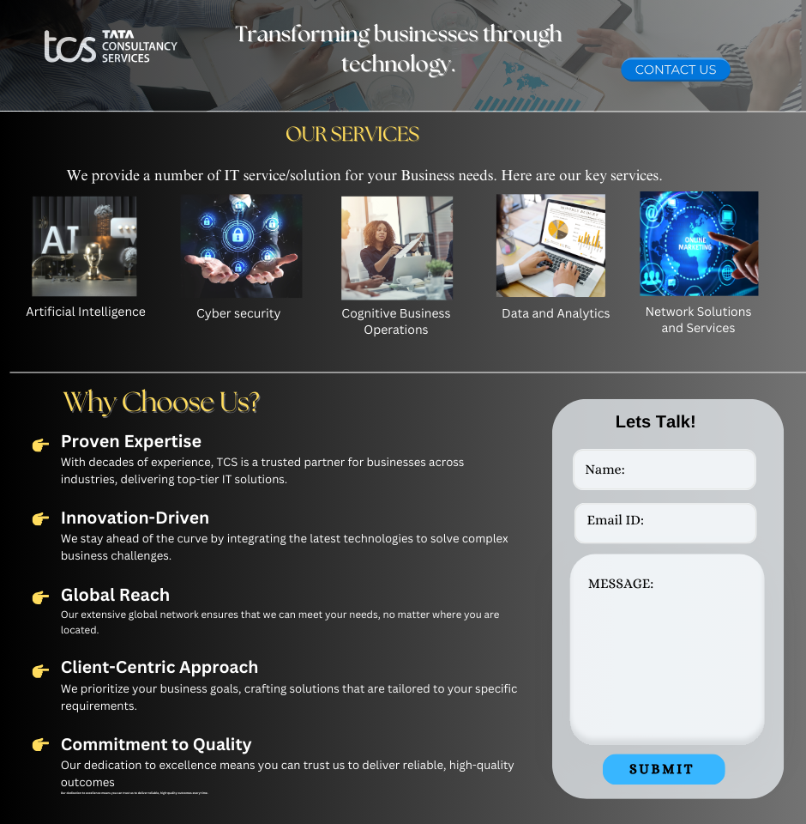

Landing Page Design
Website :https://www.tcs.com/

Slide 17
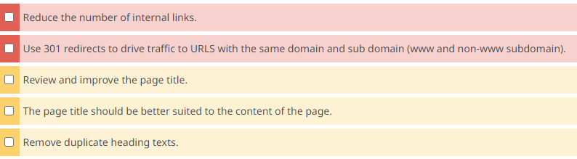
RECOMMENDATIONS:

Slide 18
CONCLUSION:
We have analyzed tcs.com website and identified the technology stack used to build the website.
We have also tested the website responsiveness for five service pages and established the performance metrics.
Design mistakes for the same has been identified.
Also, we have designed a landing page for the TCS.com site.

Slide 19

THANK YOU!

